Slide 1



Choice Of Technology
Frontend: React
Backend: NestJS and Postgres
Using free tier DB from Heroku so all the data is already there :D
Website > Mobile due to security restrictions !

Slide 2
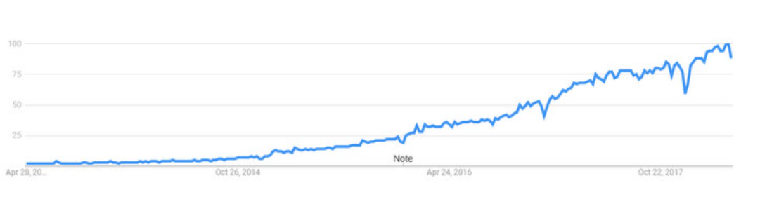
Choice Of Technology [React Frontend]
One of the most popular framework -> Have a lot of support from developers and many new libraries to use
Faster rendering with use of virtual DOM, especially good for dynamic software
Ability to create reusable components -> greater maintainability and scalability

Slide 3
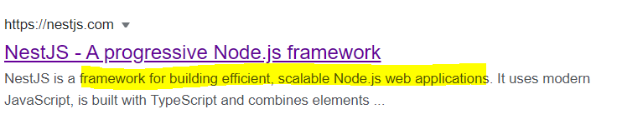
Choice Of Technology [NestJS Backend]
Build on Nodejs. Fastest growing Node.js framework
libraries that can be used in Nodejs can be used in NestJS with some changes
Scalability -> The use of typeorm and ability to easily create microservice architectures
NestJS makes it easy to create resources (Modules/Services/Controllers etc.)
No need to create table on your own, let NestJS do it for you ☺

Slide 4
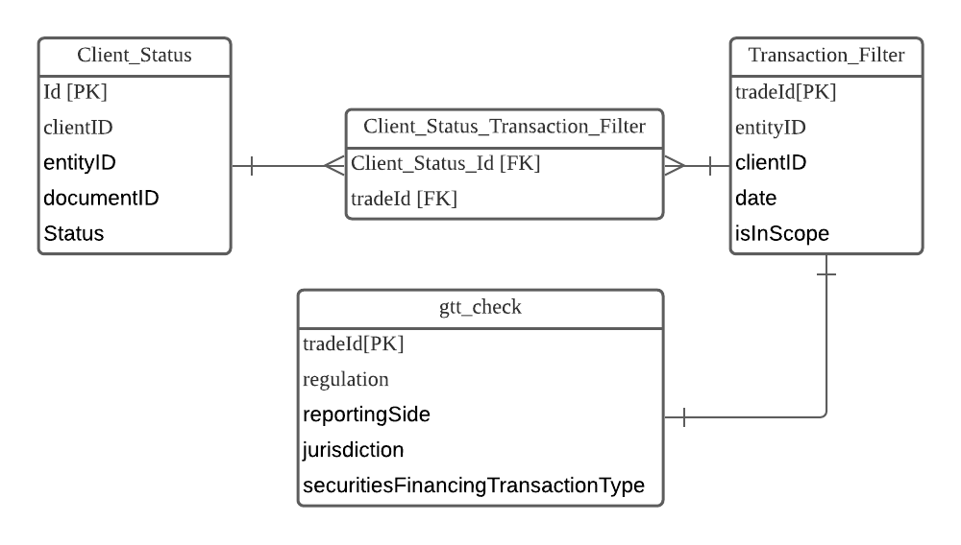
Design Of Database
Many to Many Relationship between Client Status and Transaction Filter -> Intermediary table created.
Splitting trade data into 2 tables, Transaction_Filter and gtt_check.
With the use of isInScope column, it is unnecessary to query regulation, reportingside, jurisdiction, securitiesFinancing TransactionType. More efficient query.

Slide 5
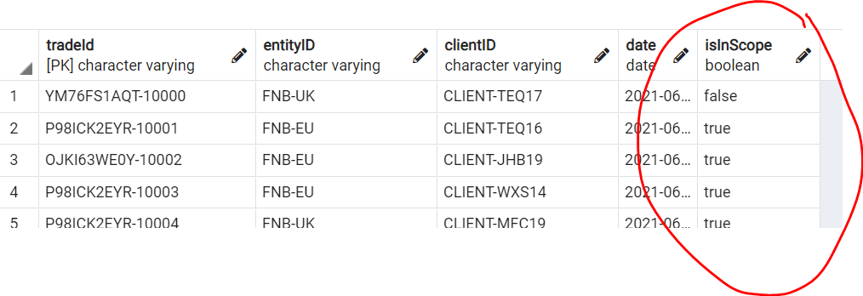
Design Of Database
Addition of isInScope column. The isInScope column is true if the trade is in scope to perform a good to trade check based on the 5 condition.
Pros
Reduce the need to join 2 tables and do a check of 5 conditions at every query. Check is only done when data is inputed to the database. More efficient.
Cons
If trade information is updated, the isInScope value may change.
Decision: Add isInScope. As the data is historical, it is much less likely that it would be updated compared to frequency of query of data.

Slide 6
API Design
NO Path Variable – We are not querying a specific resource
NO Body – We are just getting with GET request, not creating new resources
YES - Query Parameters – For sorting or filtering out resources
E.g. http://localhost:3000/client-status/client?clientid=CLIENT-9YL14

Slide 7
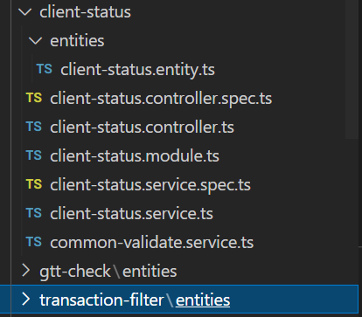
Backend Design MVCS - Model View Controller Service
Model – Structure Of Table (Entity)
View – Structure Of Response
Controller – API logic
Services – Application/backend logic
Each have single responsibility

Slide 8
Backend Design MVCS - Model View Controller Service
Modularity – Split services to 2 classes (client status and common validate) for different functionality.
Common validate contains methods to be used by all 3 queries: e.g. 1 function is to check if traded/clientid/date exist in database.
Client status service contains method specific to queries.
Dependency Injection – Mocking data into controller during testing, save resources while testing backend logic

Slide 9
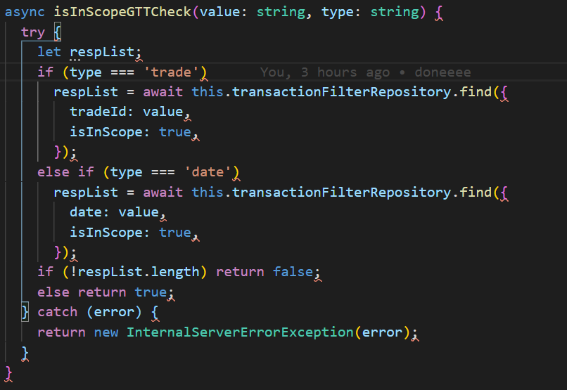
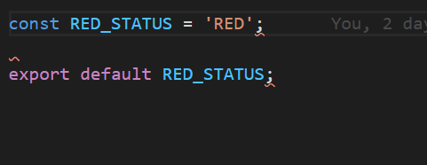
Backend Design
Each method only has ONE function. Eg this is to check if trade is in scope. This ensures readability.
Service methods are reused in backend
Input validation done in the backend instead of frontend for better security, which is a crucial element in bank.
Reusable constants are stored in utils file, reduce chance of error

Slide 10
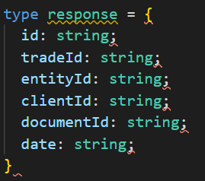
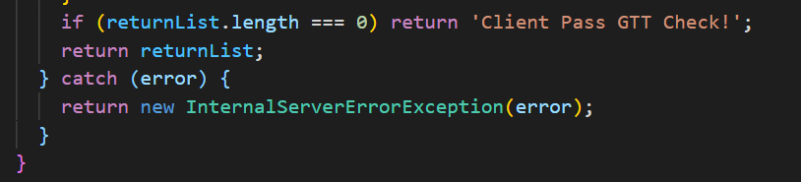
Backend Design
All 3 queries have the same response type. This ensures easy input of data to table in the frontend.
Use of early returns throughout frontend and backend.

Slide 11
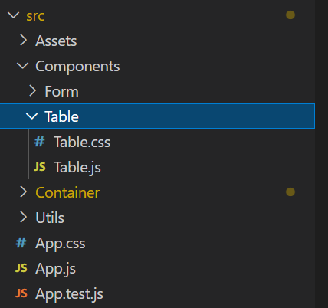
FrontEnd Design
Split into Components, Container ,Utils and Routes (in Components)
Components – Reusable components to be used for 3 queries
Container – Webpages to be displayed
Utils – Any color or text constants
Assets – any media files
No need to use redux as global state management not required.

Slide 12
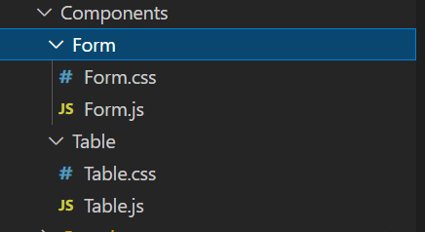
FrontEnd Design
Form component reused for query by client id and trade id
Table component reused for all 3 queries.

Slide 13
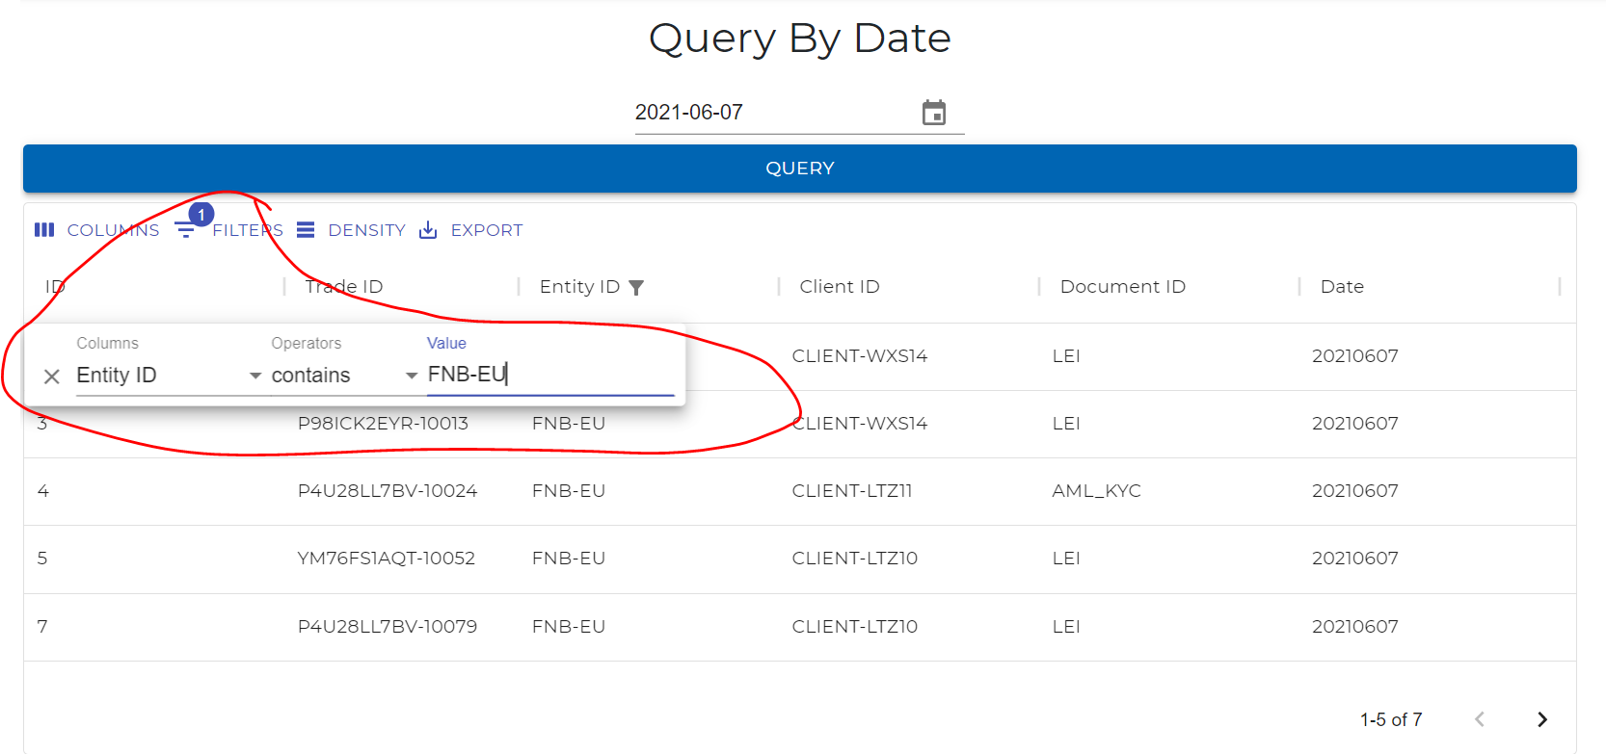
Frontend Filter
Use of filters in the table
Able to choose row to filter by and filter value
Click on ‘Columns’ button to filter columns you want to see only
Click on table headers to sort by descending or ascending

Slide 14
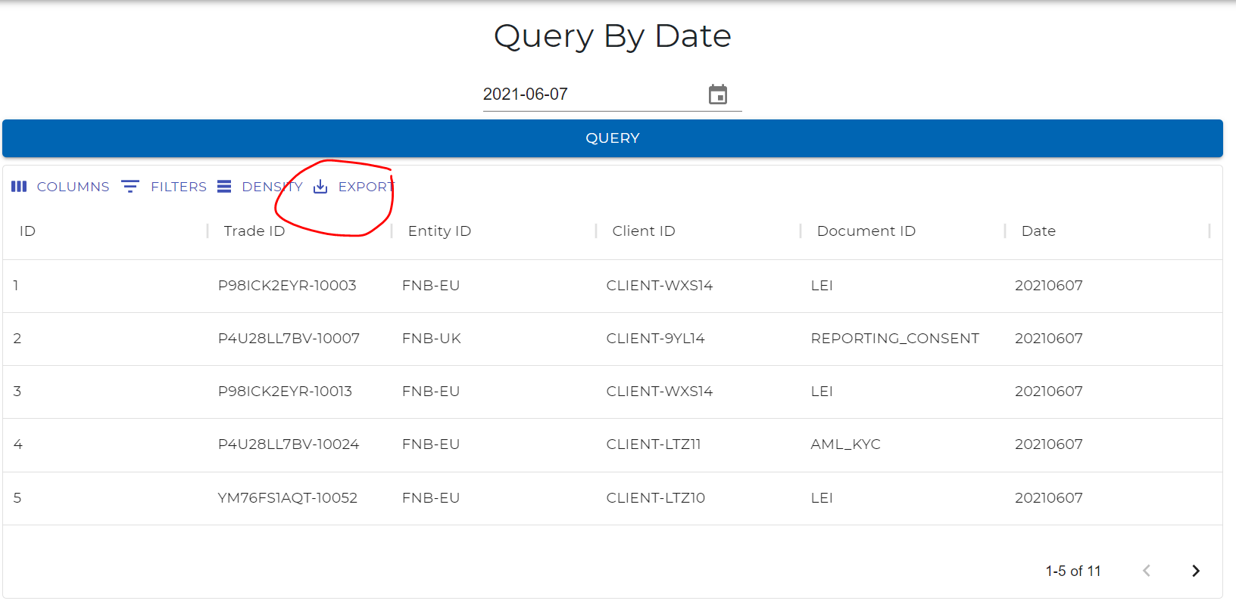
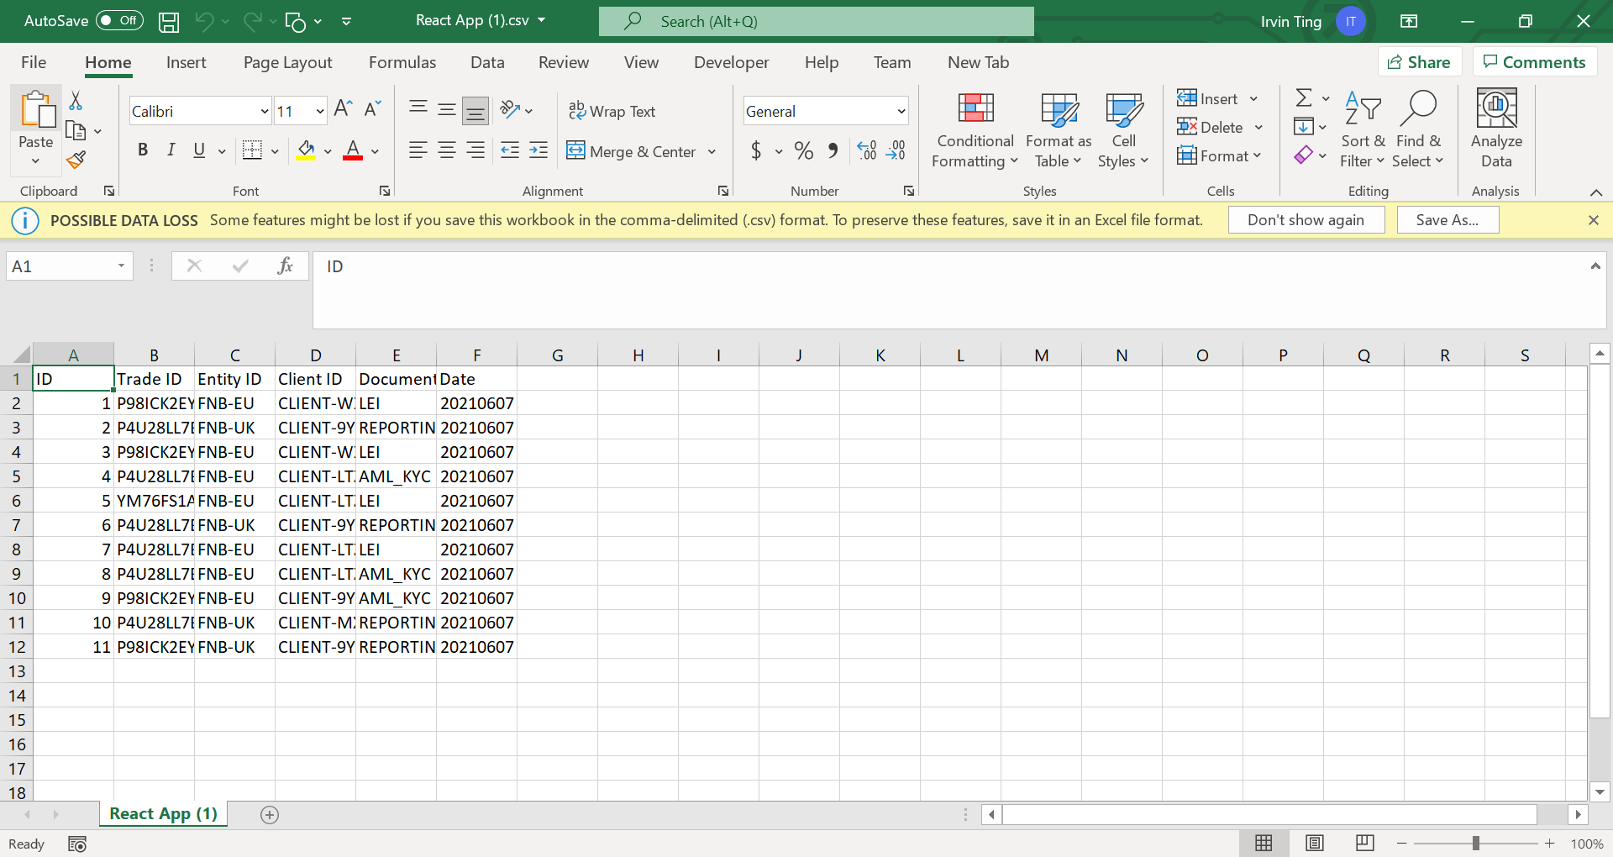
Frontend Export
Export to csv functionality for data collection.
Important for business users, especially those that are not technically trained to retrieve and view data.

Slide 15
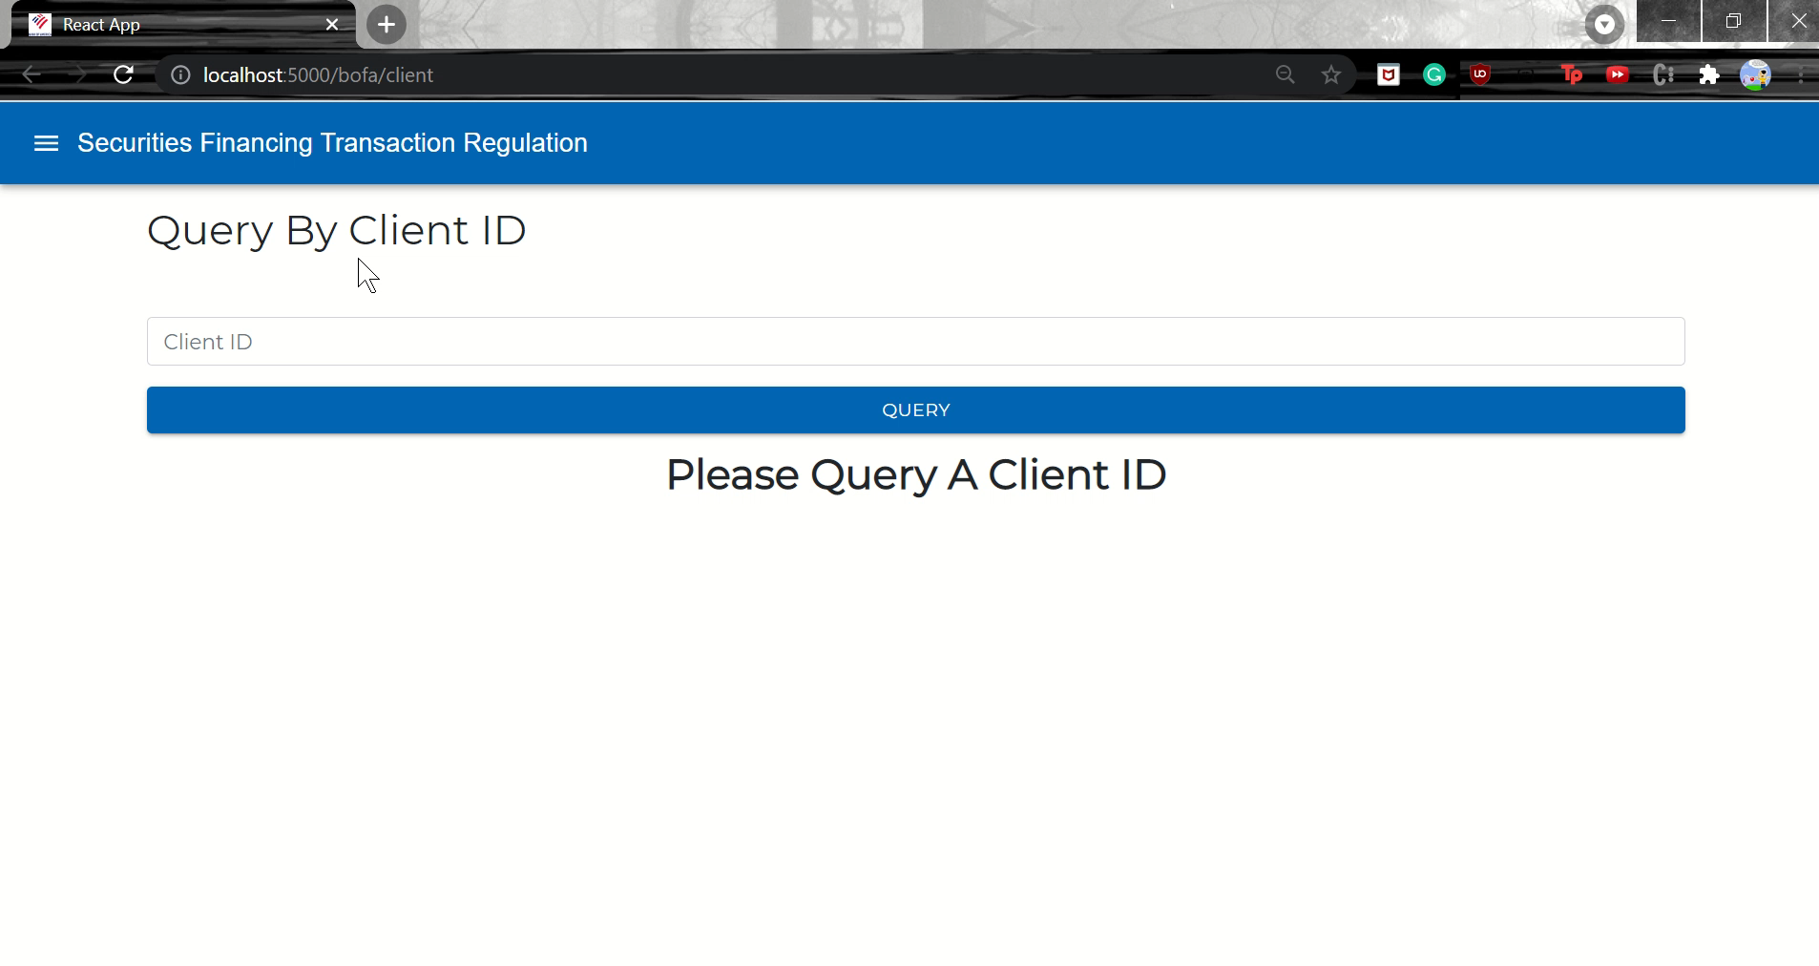
Short Demo

Slide 16
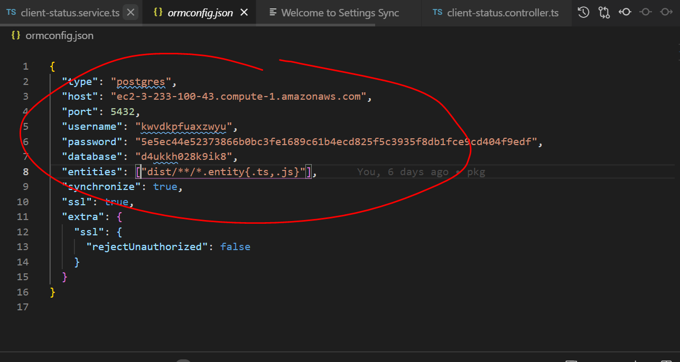
Installation Guides
Need: NodeJS, VSCode
Use my DB instance! Config on orm.config file on Postgres
Go to backend path:“\gtt\be\gtt” and run:
1. npm install
2. npm run-script build
3. npm start
Go to frontend “gtt\frontend\sftr_gtt”
and run:
1. npm install
2. npm start

